Slide 1
MARKET STRUCTURE
Kumbukani Tembo
Department of Agri-Sciences

Slide 2
TOPICS
Externalities
Public Goods
Market Structure (Perfect competition, oligopoly, monopolistic competition and monopoly)
Elasticity and its application
Labour Markets
Game Theory
General Equilibrium
Consumer Theory

Slide 3
Market in Economics?
In common usage, by market, we mean a place where commodities are bought and sold.
In Economics however, the term “Market” does not refer to a particular place as such but it refers to a market for a commodity or commodities.
It refers to an arrangement whereby buyers and sellers come in close contact with each other directly or indirectly to sell and buy goods .
Notes:
Thus, a market place is thought to be a place consisting of a number of big and small shops, stalls and even hawkers selling various types of goods.

Slide 4
Market in Economics?..
For the existence of a market, buyers and sellers need not to personally meet each other at a particular place.
They may contact each other by any means (phone, email, etc.)
Thus, the term “Market” is used in economics in a typical specialized sense. It does not refer only to a fixed location.
A market signifies any arrangement in which the sale and purchase of goods take place.
Contact and contactless as in online buying and selling.

Slide 5
Market Structure..
The characteristics and organization of market that influence the behavior of firms and determine the nature of competition and pricing strategies.
Key features of market structures
Number of sellers and buyers
Nature the product
Entry and exit barriers
Level of information symmetry
Market power

Slide 6
Features of market structure
Number of seller and buyer
The extent of competition depends on how many participants are in the market.
Nature of the product
Whether the products are homogenous or differentiated
Entry and exit barrier
The ease or difficulty for firms to enter or leave the market
Level of information symmetry
Availability and transparency of information for buyers and sellers.
Market power
The ability of firms to influence market prices.
Notes:
Homogenous products: Products that identical in all respects, with no distinguishable differences in quality, features, or appearances.
Characteristics of homogenous products:
Perfect substitutes for one another.
Price is the only determining factor for buyers
Producers compete mainly on prices
Examples: Basic commodities (sugar, salt), Raw materials (wheat, maize, )
*Differentiated Products: Products that are similar but have variations in quality, features, design, branding, or customer experience.
Characteristics
Not perfect substitutes
Producers compete for both price and non-price factors (advertising, packaging..)
Consumers may prefer one product over another based on attributes beyond price.
Examples: Smartphones, Cars, Soft drinks

Slide 7
Type of Market structures
Perfect competition
Monopoly
Monopolistic competition
Oligopoly

Slide 8
Perfect Competition
Perfect Market is a market situation which consists of a very large number of buyers and sellers offering a homogeneous product.
In practice businessmen use the word competition as synonymous to rivalry.
In theory, perfect competition implies no rivalry among firms.
Under such condition, no firm can affect the market price.
Price is determined through the market demand and supply of the particular product, since no single buyer or seller has any control over the price.
Notes:
Closest Example: Agricultural markets/Stock exchange market
But, Perfect Competition cannot be found in the real world.
The firm’s objective is to produce the level of output that will maximize profit

Slide 9
Characteristics of a Perfect Competition
Large number of buyers and sellers
All producers sell the same product (homogenous )
Free entry or exit
Perfect knowledge of the market (
Existence of a single and uniform price
Firms are price takers
Government non-intervention
Notes:
There are no barriers to enter the market
Entry Barriers: Obstacles that make it difficult to enter an industry and compete with existing firms.
Economic barriers (High startup costs, economies of scale)
Legal and Regulatory barriers (Licensing requirements, patents and intellectual property)
Technological barriers (Access to advanced technology, Brand loyalty, network effects)
Exit Barriers: Challenges or costs that frims face when attempting to leave a market.
Sunk Costs: Irrecoverable investments in equipment, infrastructure, or research and edevelopment
Contractual obligations
Legal and regulatory restrictions
Asset disposal issue

Slide 10
Perfect Competition..
The industry is defined as a group of firms producing a homogeneous product.
The assumptions of large numbers of sellers and of product homogeneity imply that the individual firm in pure competition is a price-taker: its demand curve is infinitely elastic, indicating that the firm can sell any amount of output at the prevailing market price.
It is assumed that all sellers and buyers have complete knowledge of the conditions of the market.
Entry or exit may take time, but firms have freedom of movement in and out of the industry.
There is no government intervention in the market (tariffs, subsidies, rationing of production or demand and so on are ruled out).
Notes:
Entry Barriers: Obstacles that make it difficult to enter an industry and compete with existing firms.
Economic barriers (High startup costs, economies of scale)
Legal and Regulatory barriers (Licensing requirements, patents and intellectual property)
Technological barriers (Access to advanced technology, Brand loyalty, network effects)
Exit Barriers: Challenges or costs that frims face when attempting to leave a market.
Sunk Costs: Irrecoverable investments in equipment, infrastructure, or research and edevelopment
Contractual obligations
Legal and regulatory restrictions
Asset disposal issue

Slide 11
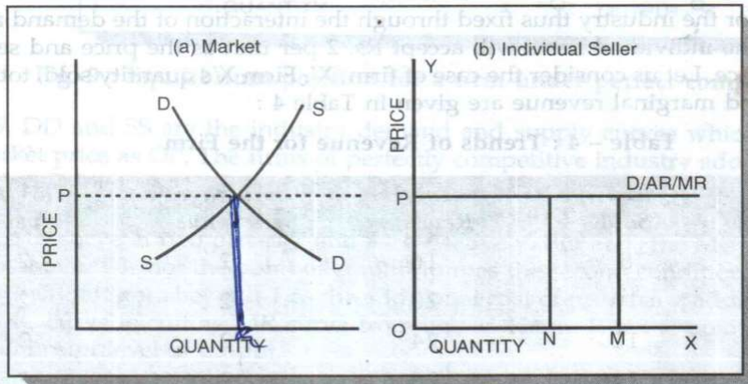
Fig 1: The firms` demand curve under perfect competition
Notes:
The demand curve facing the individual firm in a perfectly competitive market is horizontal at the level of market price set by the industry and the firms have the freedom of choosing the level of output which yields maximum profit.
Normal supply and demand
More supply at higher price
Firms are price takers

Slide 12
Imperfect markets
In economic theory, imperfect competition is a type of market structure showing some but not all features of competitive markets.
Forms of imperfect competition include:
Monopoly
Oligopoly
Monopolistic competition

Slide 13
Monopoly
comes from a Greek word ‘monos’ which means ‘one’ and ‘polein’ means to ‘sell’.
There is only one seller of goods or services
A monopoly should be distinguished from a cartel.
Cartel refers to a market situation in which firms agree to cooperate with one another to behave as if they were a single firm and thus eliminate competitive behavior among them.)

Slide 14
Monopoly…
There is only one producer or seller of goods and only one provider of services in the market.
✓ New firms find extreme difficulty in entering the market. The existing monopolist is considered giant in its field or industry.
There are no available substitute goods or services so that it is considered unique.
It controls the total supply of raw materials in the industry and has no control over price.
Its operations are under economies of scale.
Notes:
Economies of scale
Refer to the cost advantages that a business experiences as it increases production.
As the scale of production grows, the average cost per unit of output decreases.
This happens because fixed costs are spread over more units, operational efficiencies improve, and bulk purchasing reduces input costs.

Slide 15
Classifications of monopoly
Natural monopoly
is a market situation where is a single firm can supply the entire market due to the fundamental cost structure of the industry.
Legal monopoly
is sometimes called as de jure monopoly, a form of monopoly which the government grants to a private individual or firm over the product or services.
Coercive monopoly
is a form of monopoly whose existence as the sole producer and distributor of goods and services is by means of coercion (legal or illegal), so that most of the time it violates the principle of free market just to avoid competition.
Notes:
Monopolies are classified according to circumstances they arise from, that is, cost structure of the industry, possibly the result of law, or by other means

Slide 16
Characteristics of a monopoly
Single seller in the market
No close substitutes
No competition
Price maker
Entry barriers for new firms
Can fix both price and output
Notes:
Close substitutes?: Goods that serve a similar purpose and can replace each other, but they are not identical.
Consumers may switch between them based on price, quality, brand preference etc……EXAMPLE: Tea & Coffee, Cocacola & Pepsi,
Perfect substitutes: Goods/ services that can be used in place of each other with no difference in consumer preference….EXAMPLE: Bottled water of identical price and quality, Different brands of Salt/

Slide 17
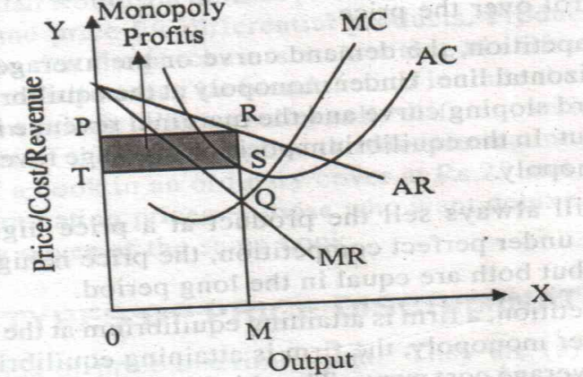
Fig 2: Demand curve of Monopoly
AR is a downward sloping curve.
The MR curve falls below the average revenue curve.
The monopolist is in equilibrium by equating MC and MR.
He will produce up to the point and charges a price which bring its maximum money profits.
The firm will go on producing as long as MR=MC.
MC and MR are equal at the point Q.
Notes:
MR is the marginal revenue curve.
MC-: Refers to thee additional costs incurred when producing one more unit of a good/service…..calculated as MC=Change in TC/Change in quantity produced
MR-: The additional revenue earned from selling one more unit of a good or service……calculated ast change in TC/Change in quantity sold
AR revenue curve of the monopolist is a downward sloping curve if a monopolist wants to sell more he has to reduce the price of his product.

Slide 18
Oligopoly
comes from the Greek word “oligo” which means ‘few’ and “polein” means ‘to sell’.
small number of sellers, each aware of the action of others.
All decisions depend on how the firms behave in relation to each other.
In oligopoly, conjectural interdependence is present, that is, the decision of one firm influences and are influenced by the decision of other firms in the market.

Slide 19
Characteristics of oligopoly
There are a small number of firms in the market selling differentiated or identical products.
The firm has control over price because of the small number of firms providing the entire supply of a certain product.
There is an extreme difficulty for new competitors to enter the market.

Slide 20
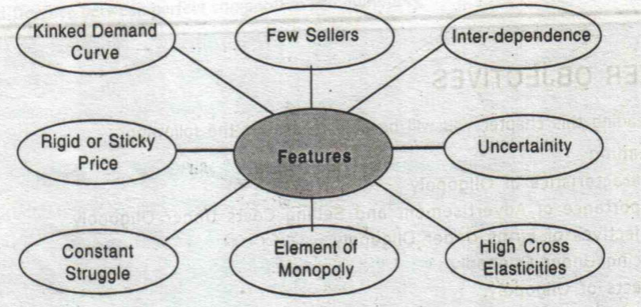
Characteristics of oligopoly..

Slide 21
Types of oligopoly
Pure or Perfect Oligopoly
If the firms produce homogeneous products
Imperfect or Differentiated Oligopoly
If the firms produce differentiated products
Collusive Oligopoly
If the firms cooperate with each other in determining price or output or both
Non-collusive Oligopoly
• If firms in an oligopoly market compete with each other

Slide 22
Types of oligopoly
Cartel is a formal agreement among oligopolists to set-up a monopoly price, allocate output, and share profit among members.
Collusion is a formal or an informal agreement among oligopolists to adopt policies that will restrict or reduce the level of competition in the market.

Slide 23
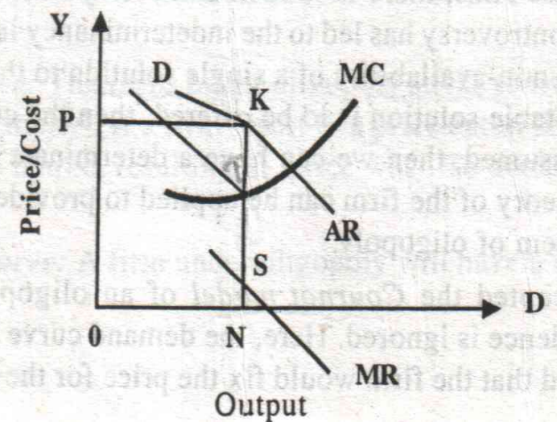
Fig 3: A product under oligopoly
Since MR follows AR, there is discontinuity in the MR curve below the point corresponding to the Kink.
MC cuts the MR curve between the point T&S. Therefore equilibrium output and price do not undergo any change.
The firm will be in equilibrium producing OM level of output at OP price

Slide 24
Kinked demand curve
Kinked demand curve is defined as the demand curve of the individual firm in oligopolistic market. It has a “kink” at the existing price caused by the firm’s expectation of the actions its rivals are likely to take if the firm changes its price.
The demand curve is an oligopoly ha s a distinctive “kink” due to the different reactions of competitors to price increases and decreases:
Above the kink (price increases): The demand curve is elastic, meaning a price increase leads to a large drop in quantity demanded since consumers switch to competitors who did not raise prices.
Below the kink (price decreases): The demand curve in inelastic, meaning a price cut does not significantly increase sales since all firms lower prices simultaneously.

Slide 25
Kinked demand curve..
The kink in the deman curve results in a discontinuous marginal revenuew curve (MR), meaning that even if marginal costs (MC) change, firm may not change their prices.
Since the MR curve has a gap at the kink, as long as MC stays within this gap, the profit-maximizing firm has no incentive to change price or output.
The kinked demand curve provides a useful explanation of price stability in oligopolies, emphasizing the strategic interdependence of firms.

Slide 26
Kinked demand curve..
Implications of the Kinked Demand Curve Model
Price rigidity: Even if production costs change, firms may not change prices because the kinked demand curve makes MR curve discontinuous.
Non-price competition: Firms focus on non-price strategies like advertising, product differentiation, and customer service.
Limited price war: Firms avoid excessive price competition since price reductions are easily matched, reducing the potential benefits of undercutting rivals.

Slide 27
Monopolistic Competition
Market situation in which there are many sellers producing highly differentiated products.
Monopolistic competition is also perfect competition plus product differentiation.
Product differentiation gives each monopolistic competitor some market power, since each competitor can raise price slightly without losing all its customers.

Slide 28
Characteristics of Monopolistic Competition
A large number of buyers and sellers in a given market act independently.
There is a limited control of price because of product differentiation.
Sellers offer differentiated products or similar but not identical products.
New firms can enter the market easily. However, there is a greater competition in the sense that new firms have to offer better features of their products.
Economic rivalry centers not upon price but also upon product variation and product promotion.

Slide 29
Monopsony
A market situation in which there is only one buyer of goods and services in the market.
It is sometimes considered analogous to monopoly.
Monopsony power givers them the ability to control their unit cost for an input which is similar to the way the monopoly controls their price.

Slide 30
Reading Assignment
Shor-run analysis of monopolistic competition
Monopsony & its characteristics
Oligopsony & its characteristics

Slide 31
END OF LECTURE

